Slide 1

Cryptography
CS-486
August 28th, 2017 Paul A. Lambert

Slide 2

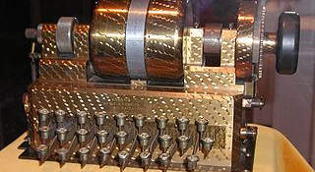
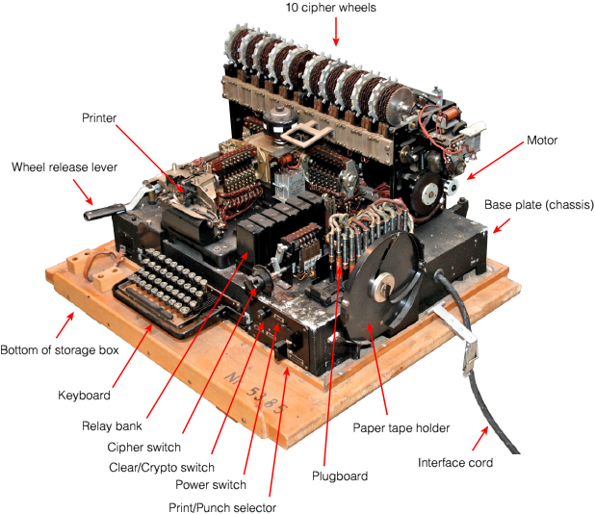
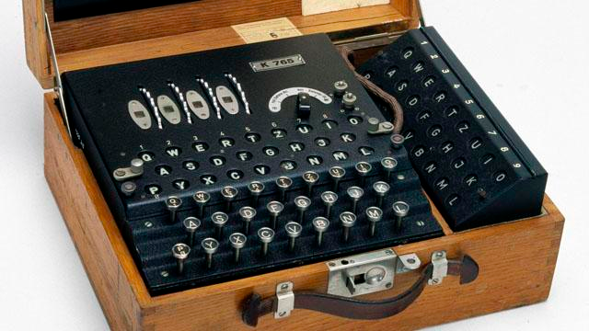
Rotor Machines

Slide 3
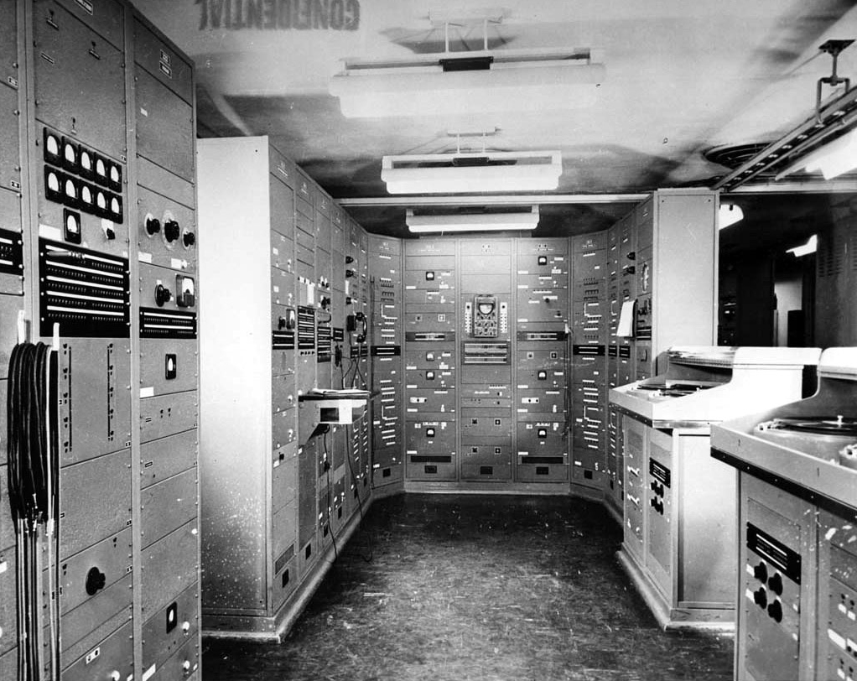
SIGSALY
1945 – The Mathematical Theory of Cryptography, Claude Shannon
https://www.nsa.gov/about/cryptologic-heritage/historical-figures-publications/publications/wwii/sigsaly-start-digital.shtml
http://www.cryptomuseum.com/crypto/usa/sigsaly/index.htm

Slide 4
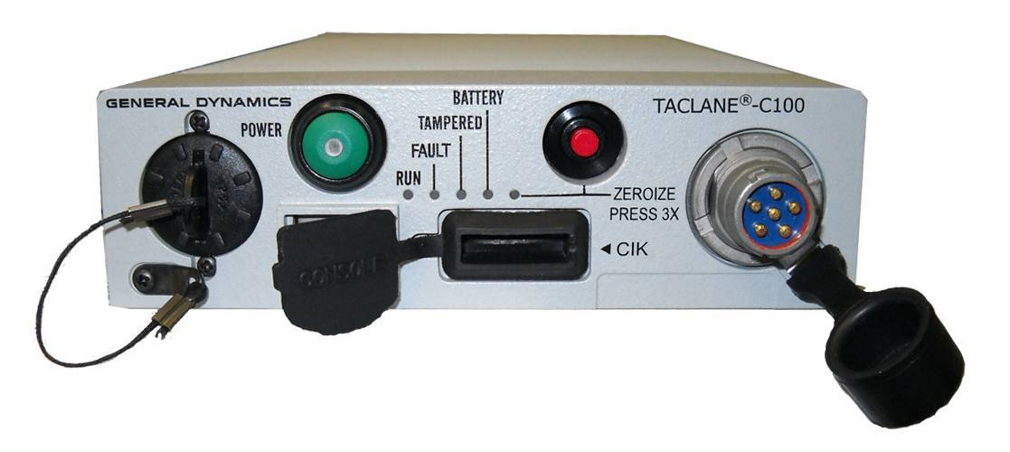
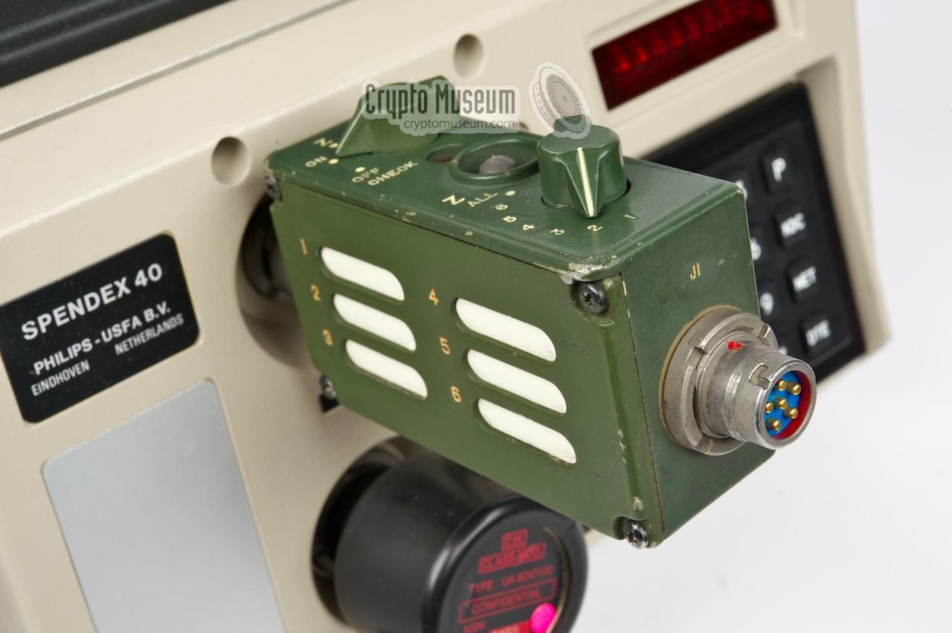
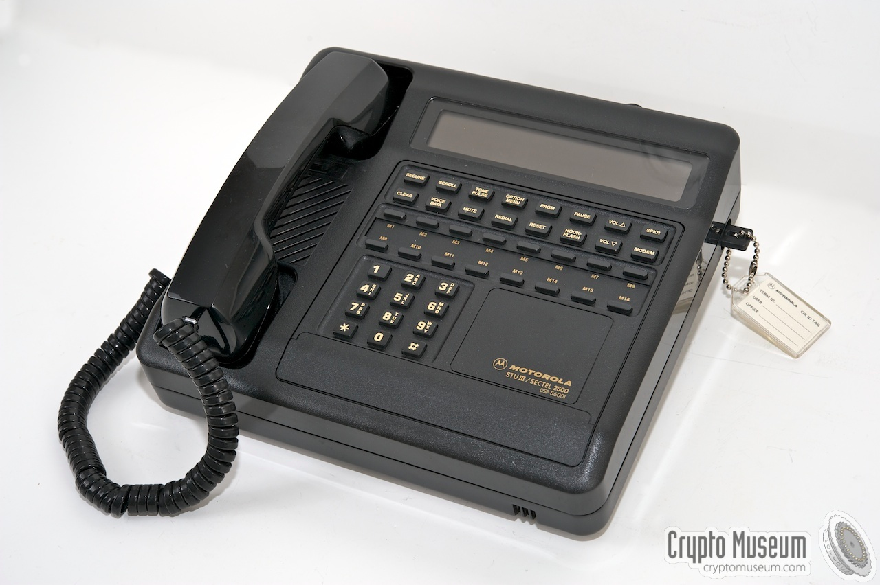
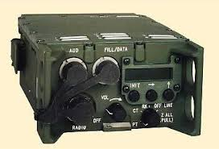
COMSEC

Slide 5
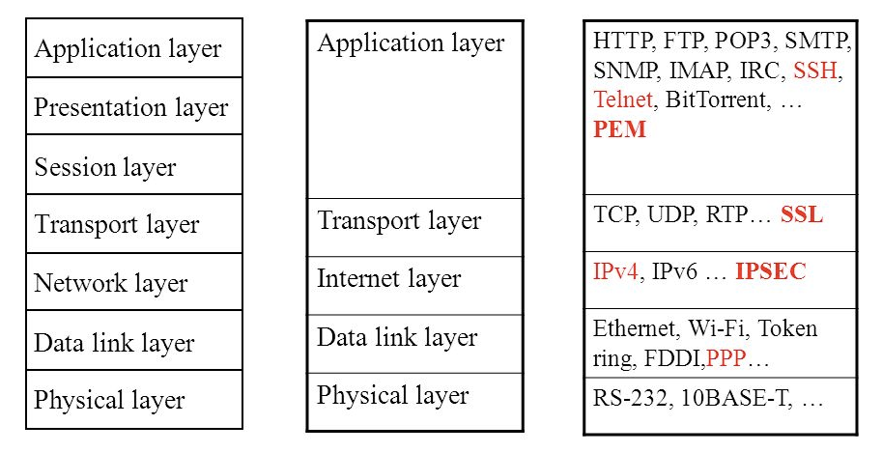
Contemporary Cryptographic Protocols
PGP, Bitcoin, DNSsec
TLS, RTP
IPsec
WPA, BT

Slide 6
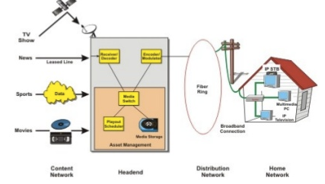
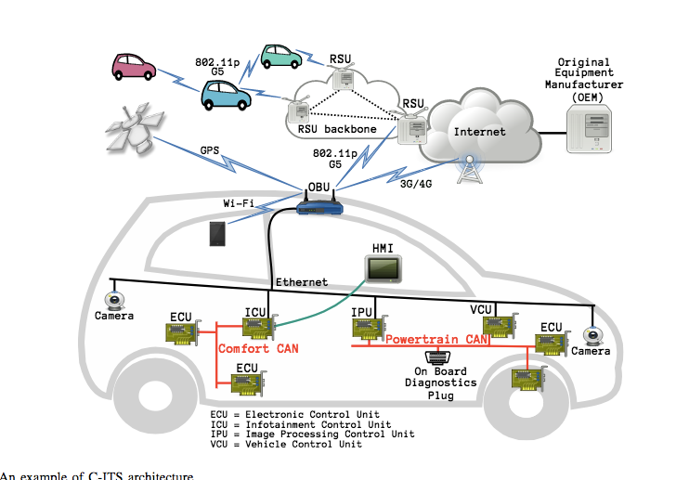
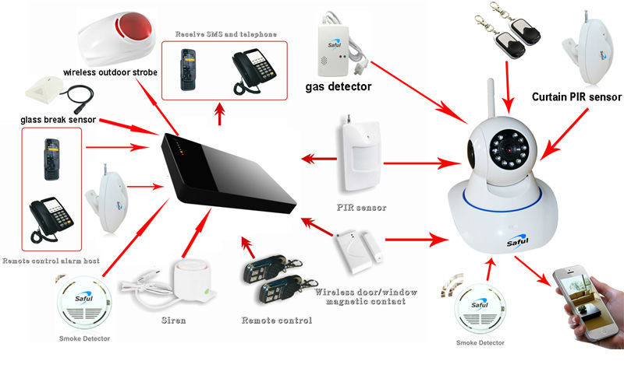
More Contemporary Cryptographic Protocols

Slide 7

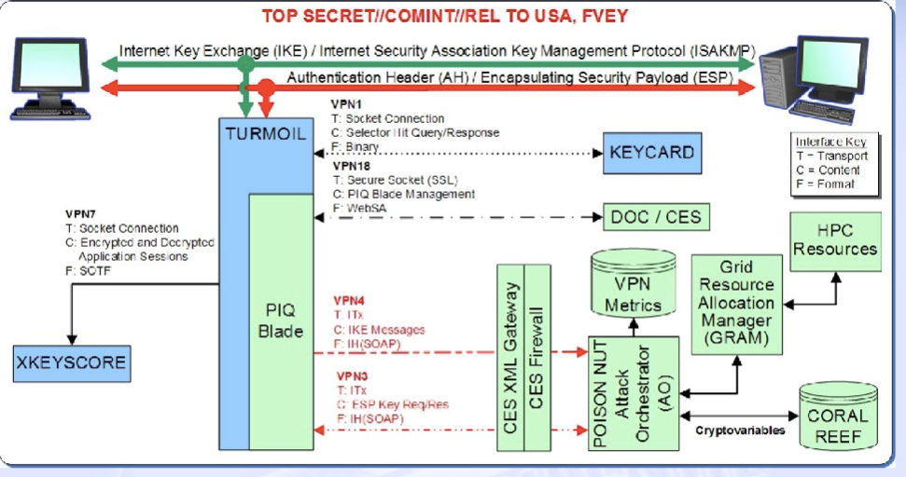
Contemporary Cryptoanalysis
https://search.edwardsnowden.com/

Slide 8
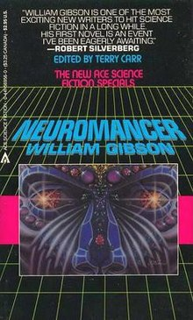
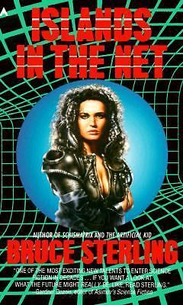
Cypherpunks Write Code.
1977 - "A new kind of cipher that would take millions of years to break”, Martin Gardner, Scientific American (August 1977)
1982 - Blind Signatures for Untraceable Payments, David Chaum
1984 – Neuromancer, William Gibson
1988 - Islands in the Net, Bruce Sterling
1989 - Commercial Internet, MCI and Compuserve
1990 - World Wide Web, Tim Berners-Lee
1992 - Achieving Electronic Privacy, David Chaum
1992 - The Crypto Anarchist Manifesto, Tim May
1993 - A Cypherpunk's Manifesto, Eric Hughes
1993 - Crypto Rebels, Wired
2009 - Bitcoin: A Peer-to-Peer Electronic Cash System, Satoshi Nakomura
2017 - Crypto Wars Timeline Daily Dot
2017 - DAOs, Democracy and Governance, Ralph Merkle

Slide 9
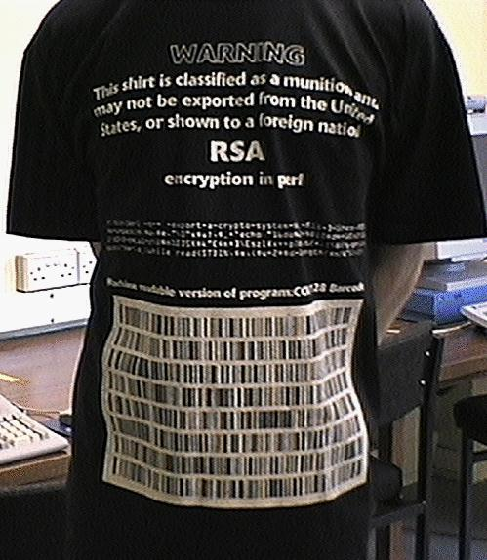
Crypto Wars

Slide 10
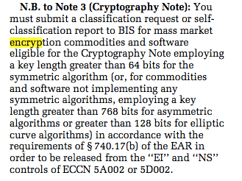
US Export Controls Today
https://www.bis.doc.gov/index.php/regulations#ear

Slide 11
Contemporary Cryptoanalysis
https://search.edwardsnowden.com/

Slide 12






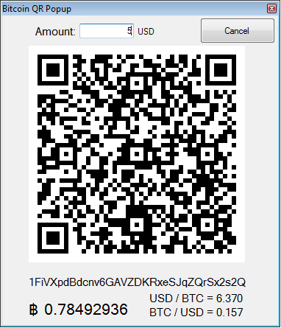


Crypto Currencies and Distributed Autonomous Organizations (DAO)
http://merkle.com/papers/DAOdemocracyDraft.pdf

Slide 13
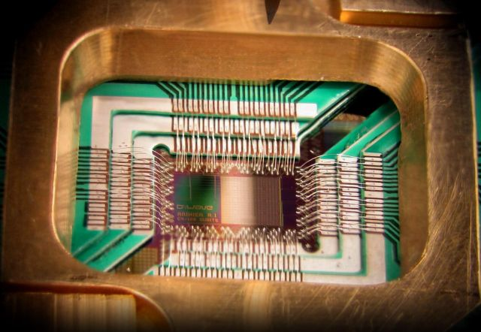
Post-Quantum Cryptography
https://arstechnica.com/information-technology/2015/08/nsa-preps-quantum-resistant-algorithms-to-head-off-crypto-apocolypse/

Slide 14
Python References
Python Documentation (Python Web Site)
Transforming Code into Beautiful, Idiomatic Python (Video)

Slide 15
References
https://marshallfoundation.org/blog/friedman-collection-folger/
http://marshallfoundation.org/library/wp-content/uploads/sites/16/2014/09/WFFvol05watermark.pdf
http://marshallfoundation.org/library/wp-content/uploads/sites/16/2014/09/WFFvol06watermark.pdf
http://marshallfoundation.org/library/wp-content/uploads/sites/16/2014/09/WFFvol07watermark.pdf
http://marshallfoundation.org/library/wp-content/uploads/sites/16/2014/09/WFFvol08watermark.pdf
https://cseweb.ucsd.edu/~mihir/cse107/index.html
https://search.edwardsnowden.com/
[MTC] A Mathamatical Theory of Cryptography, Claude Shannon, 1945
[C22] Cryptography, Andre Lange, 1922 https://archive.org/details/Cryptography_593

